Slide 1
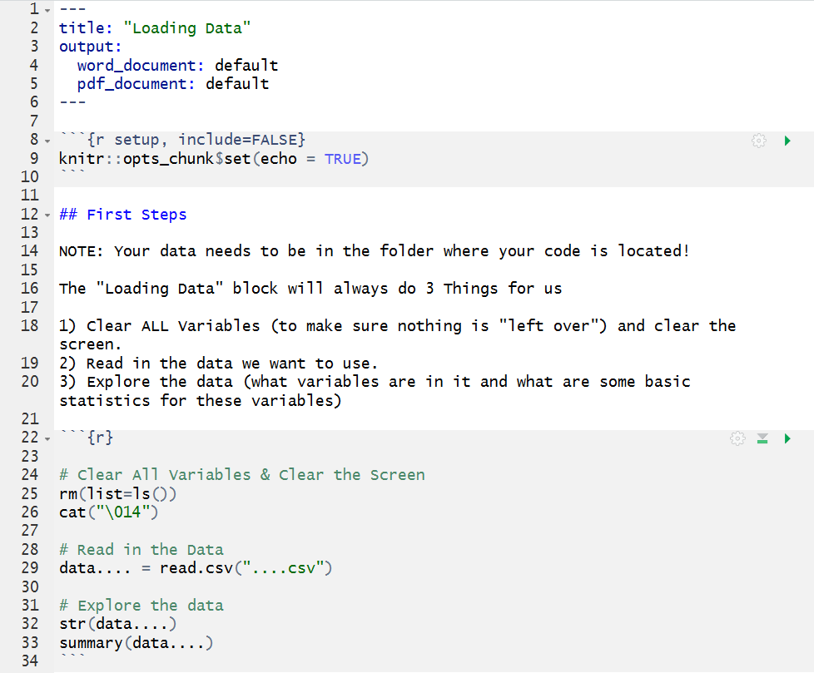
Can change Name here
Pick a name here you like, this will be the name of the data in R, I use this notation “data.price”
Name of your data goes here. Needs the file extensions, in this class we will have “.csv” files, for example “price.csv”
When wanting to use your data in R you need to call it given the name YOU gave it (in my example, “data.price”)

